Slide 1

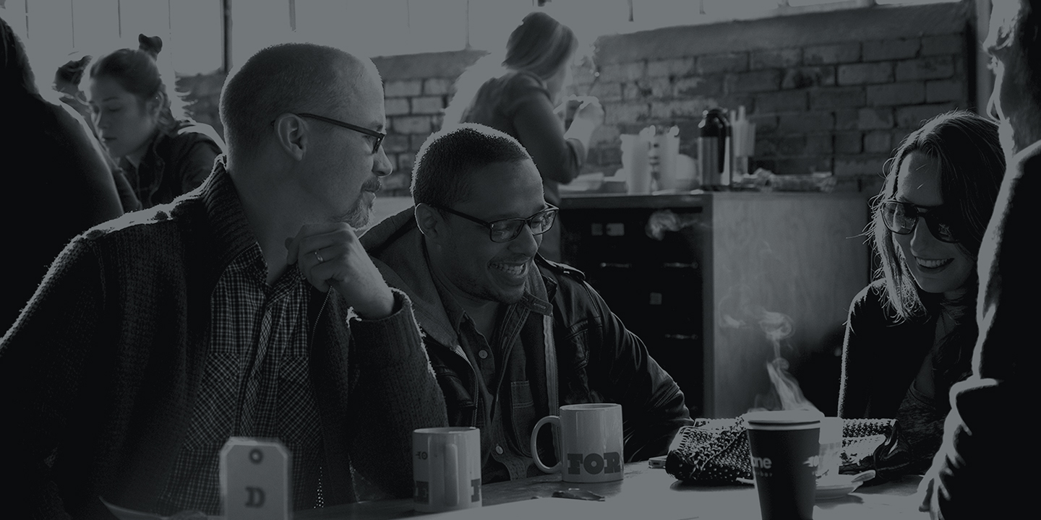
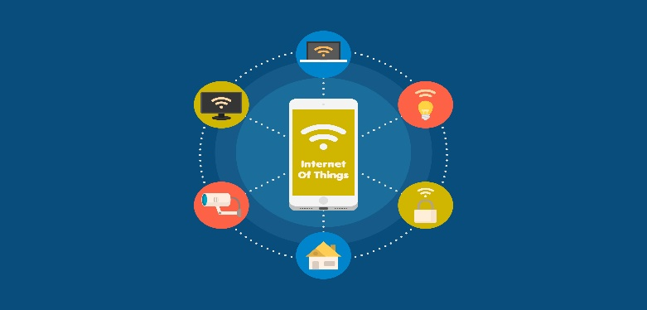
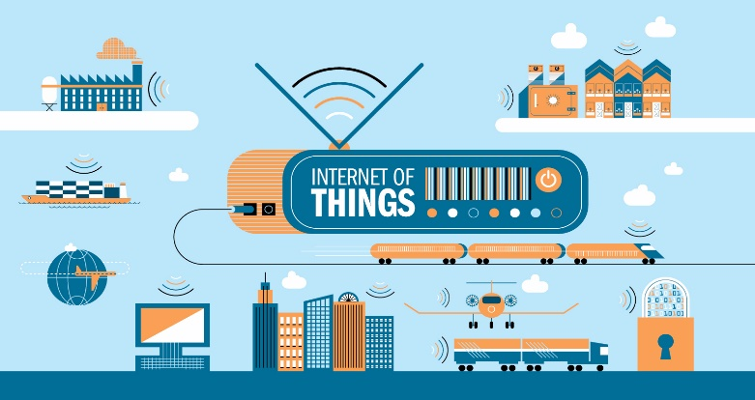
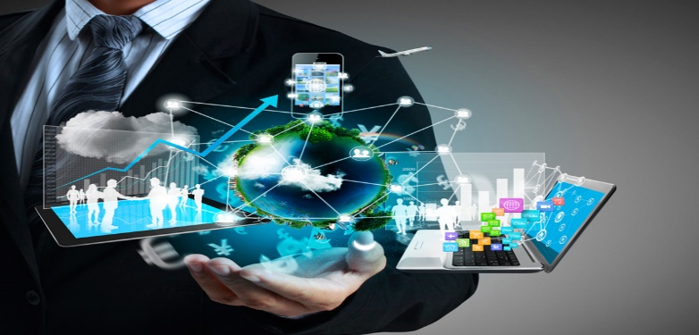
UNIVERSITY OF DA NANG
SCHOOL OF INFORMATION AND COMMUNICATION TECHNOLOGY
INTRODUCTION TO IOT
Nguyễn Đăng Quý
Nguyễn Ngọc Thương
Huỳnh Ngọc Sang

Slide 2
UNIVERSITY OF DA NANG
SCHOOL OF INFORMATION AND COMMUNICATION TECHNOLOGY
01
04
WHAT IS IOT ?
PRACTICAL APPLICATION
02
05
PIONEERS IN IOT
WHAT IS THE RISK ?
03
06
WHY SHOULD I LEARN ABOUT IOT?
PROGRAMMING LANGUAGE FOR IOT

Slide 3
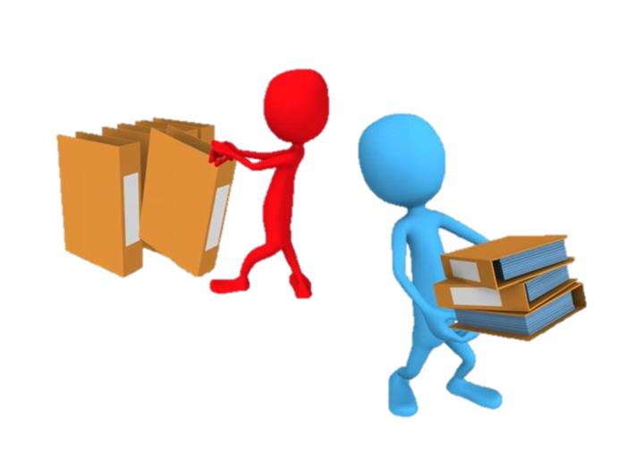
Internet of Things (IoT) is a term popular in recent years and is considered the key to open the door for future technologies.

Slide 4

01
What is IoT ?

Slide 5
What is IoT?
The Internet of Things (IoT) is a technology that helps each of objects, people joining the internet provided a separate identity and are capable of transmitting and exchanging information.
Notes:
The Internet of Things (IoT) definition.

Slide 6
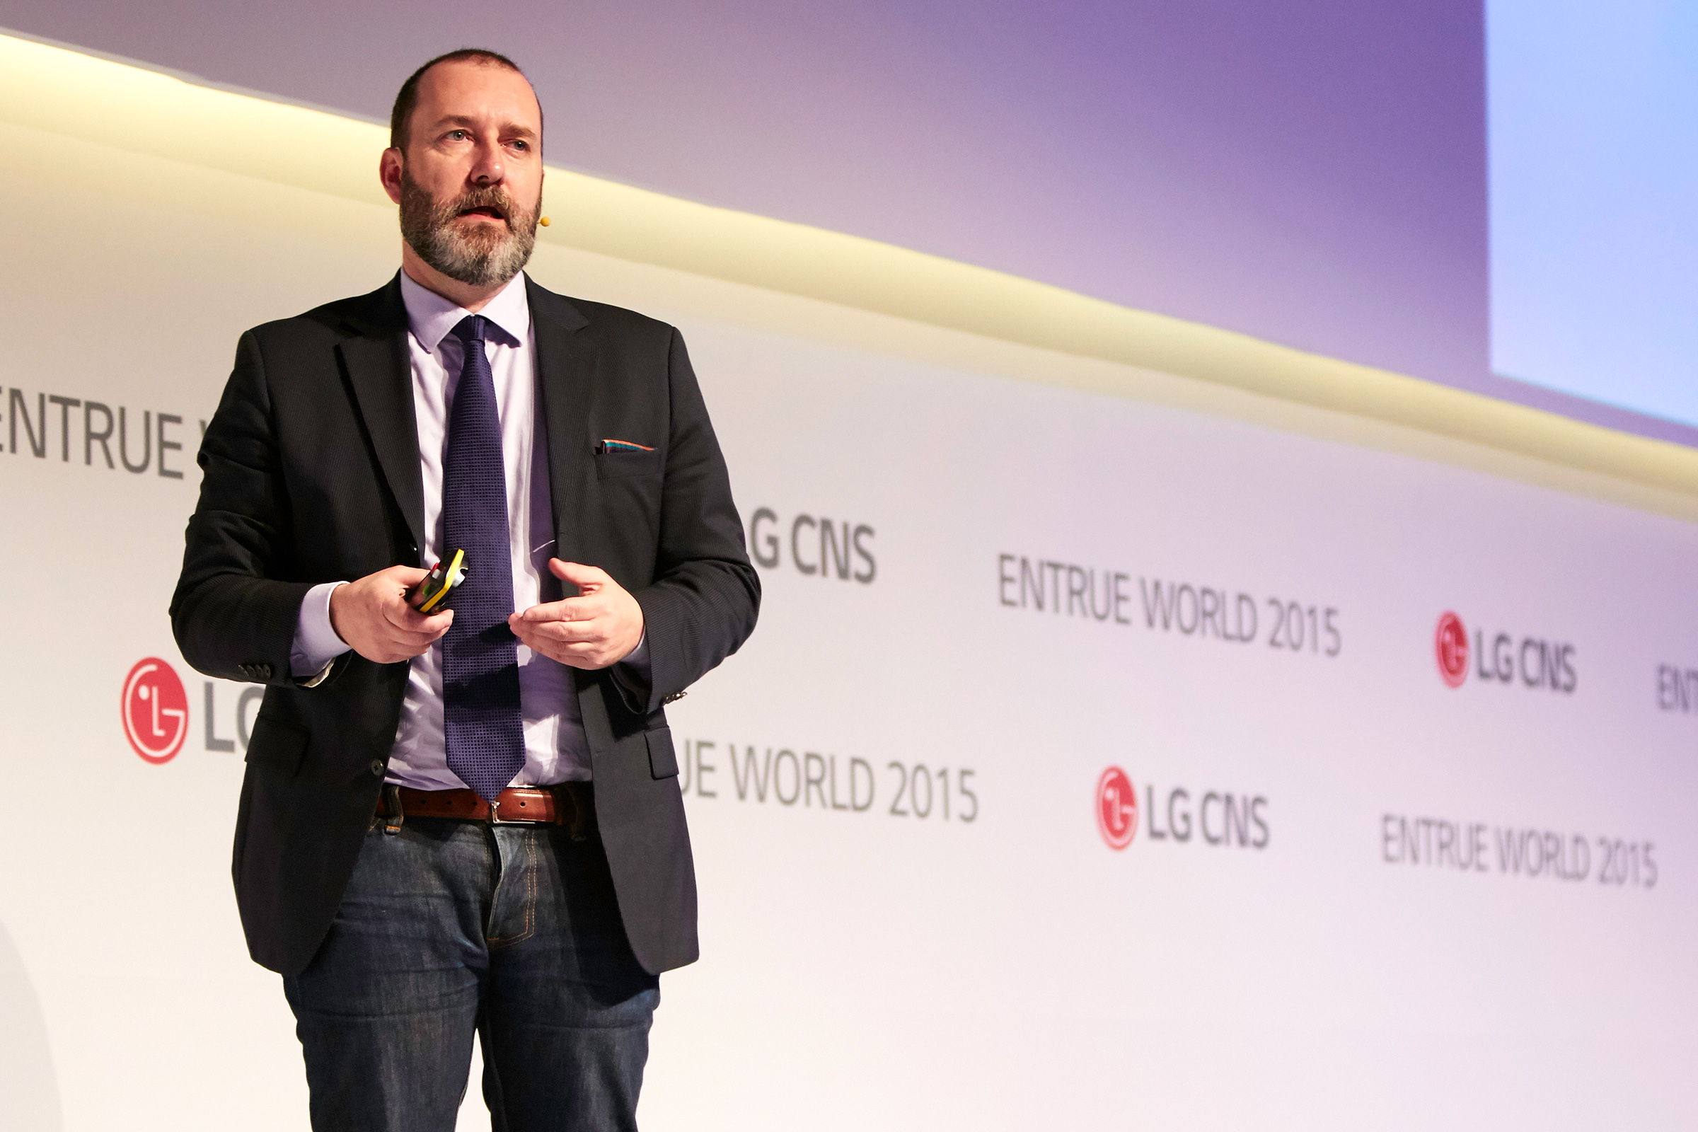

02
Pioneers in IoT

Slide 7
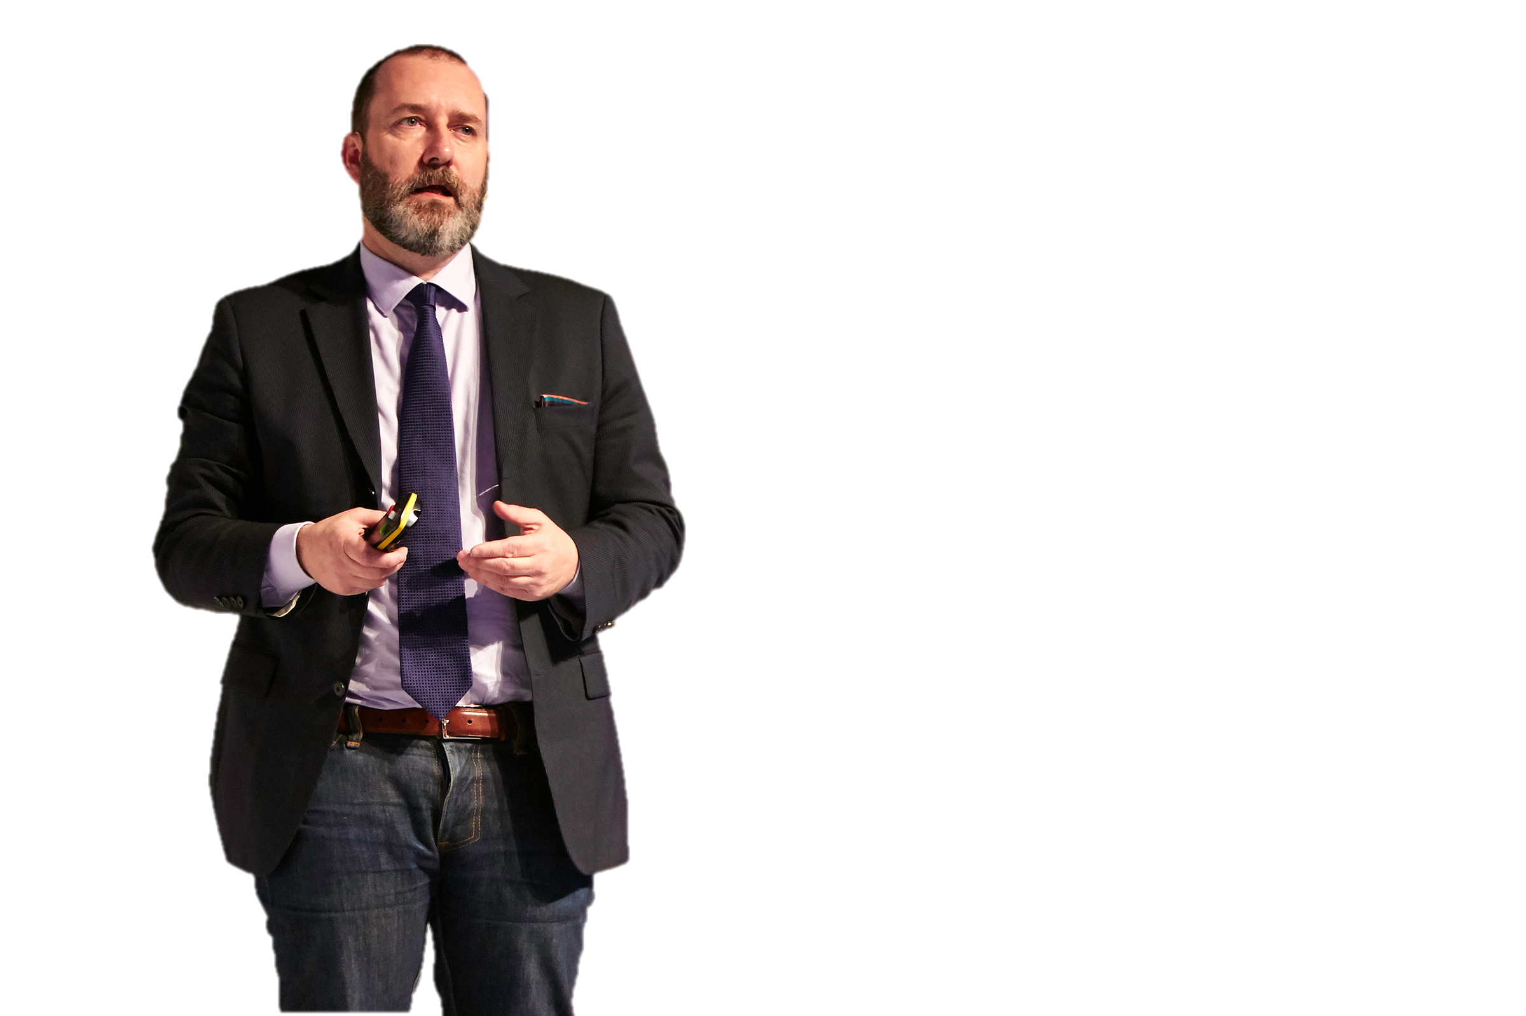
Kevin Ashton
He is a scientist who founded the center of the Auto-ID at MIT, which set the standards worldwide for RFID (a method of wireless communication using radio waves) as well as some types of other sensors.
Notes:
Ông là nhà khoa học đã thành lập trung tâm Auto-ID tại MIT, nơi đặt ra các tiêu chuẩn trên toàn thế giới cho RFID (một phương thức giao tiếp không dây sử dụng sóng radio) cũng như một số loại cảm biến khác

Slide 8

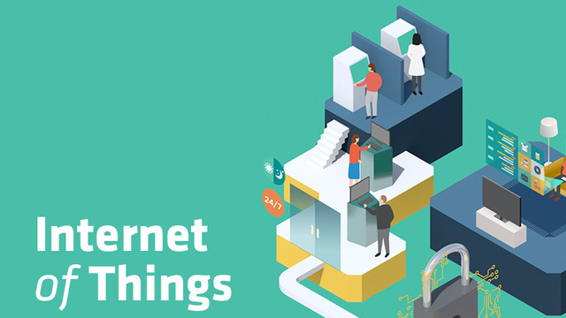
03
Why should I learn about IoT?

Slide 9
Why should I learn about IoT?
Emerging technologies
Growing IoT Services and Applications in various areas including smart cities, healthcare, transport, logistics, retail, safety and security, etc.
Business trends and new opportunities
Notes:
Mới nổi công nghệ Trồng Dịch vụ IOT và ứng dụng trong các lĩnh vực khác nhau bao gồm các thành phố thông minh, y tế, giao thông vận tải, hậu cần, bán lẻ, an toàn và an ninh, vv xu hướng kinh doanh và cơ hội mới

Slide 10
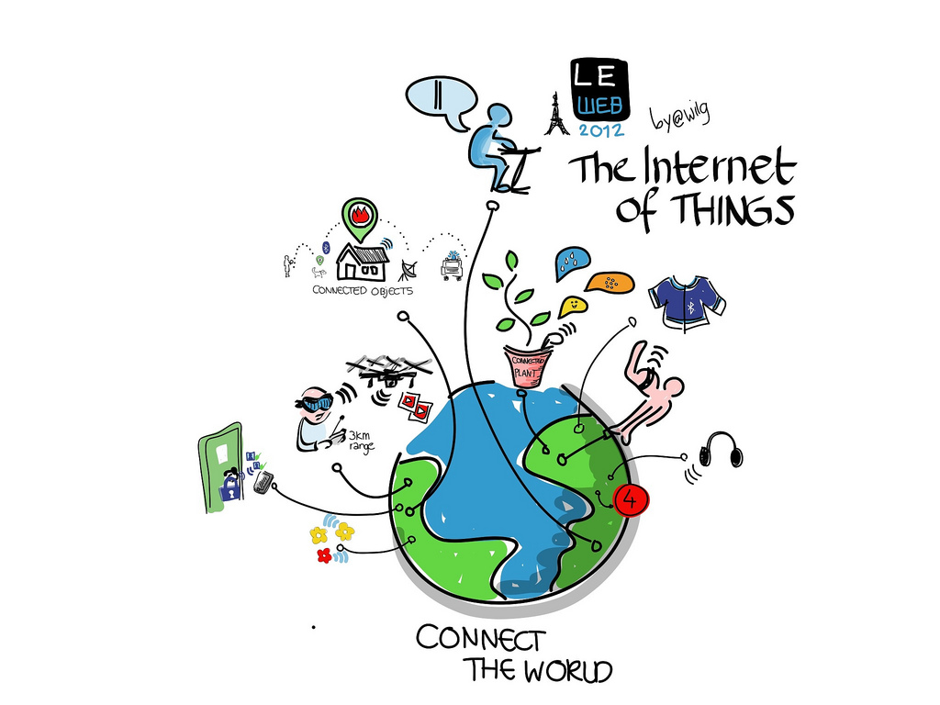
04
Practical application

Slide 11
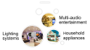
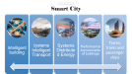
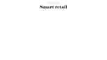

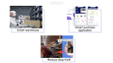
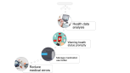
Smart Homes
Smart retail
Smart City
Healthcare

Slide 12
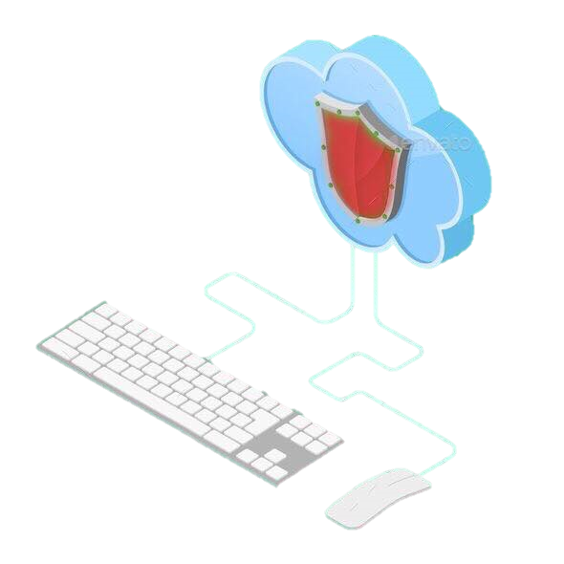
05
What is the risk ?

Slide 13
What is the risk?
Default, weak, and hardcoded credentials
Difficult to update firmware and OS
Lack of vendor support for repairing vulnerabilities
Vulnerable web interfaces (SQL injection, XSS)
Coding errors (buffer overflow)
Clear text protocols and unnecessary open ports
DoS / DDoS
Physical theft and tampering

Slide 14
06
Programming language for IoT

Slide 15
Programming language for IoT
C/C++
Java
JavaScript
Python
Assembly
Forth

Slide 16


Thank You!

Slide 17
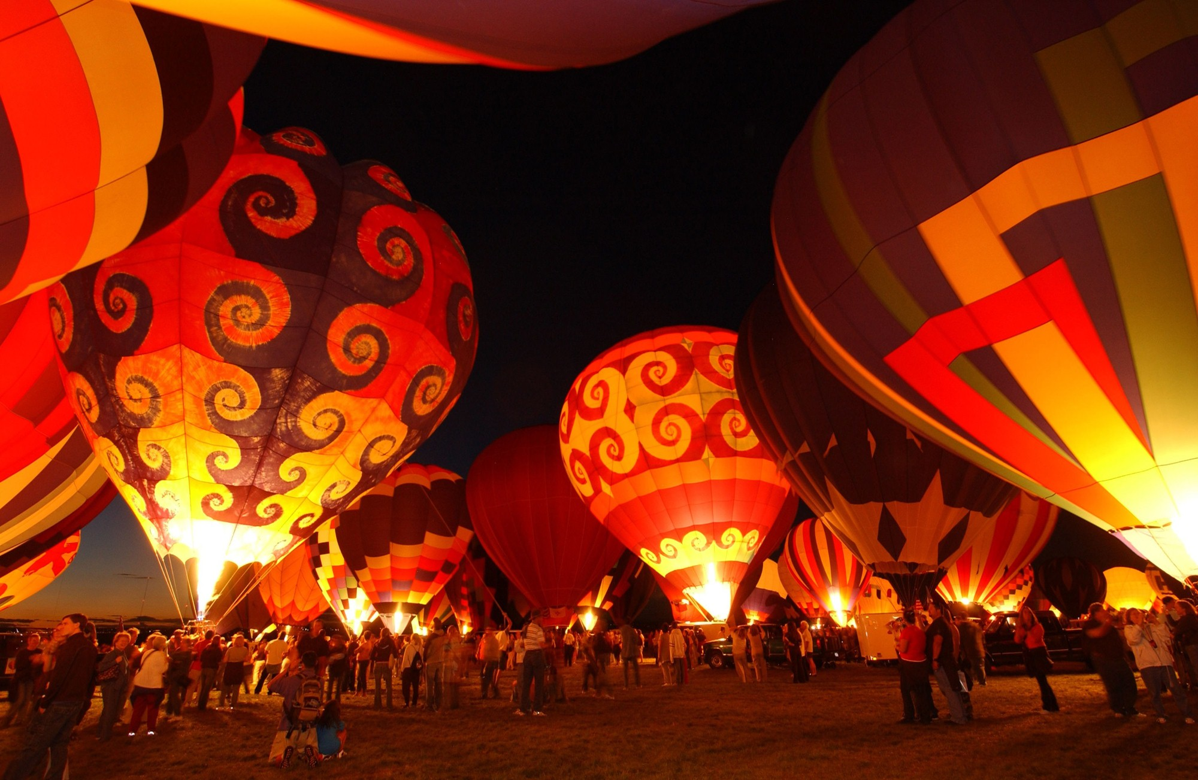
MULTIMEDIA
VIDEO SLIDE

Slide 18
Smart City
Intelligent building
Systems Intelligent Transport
Systems Distributed Energy
Performance improvements of buildings
Trams, trains and passenger ships

Slide 19
Lighting systems
Household appliances
Multi-audio entertainment

Slide 20
Reduce medical errors
Manage medication use better
Warning health status promptly
Health data analysis

Slide 21
Reduce shop theft
Smart purchase application
Smart warehouse

